Slide 1



Slide 2
Cookd YouTube Performance Analysis
Welcome to the Cookd YouTube Performance Analysis. This presentation aims to provide an in-depth analysis of the Cookd YouTube channel's content performance using key engagement metrics such as views, likes, and comments.
The analysis explores how different factors, including video duration, posting time and content types, influence audience engagement and channel growth. By leveraging data-driven insights, this project uncovers trends and patterns that can help optimize content strategy, maximize audience reach, and boost viewer engagement.

Slide 3
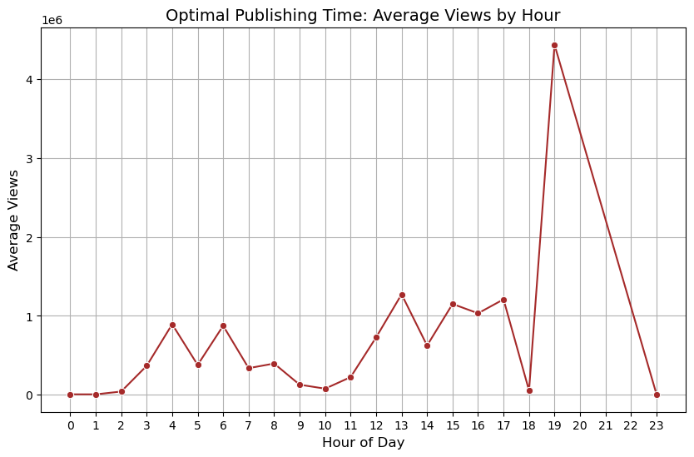
Optimal time to publish videos to maximize views
This indicates that the target audience is most active or likely to engage with content during 7PM. Publishing videos around this time can potentially lead to higher visibility and viewer engagement. Additionally, early evening hours (5 PM to 6 PM) may also be a good time to schedule content, as views begin to increase before peaking at 7 PM.

Slide 4
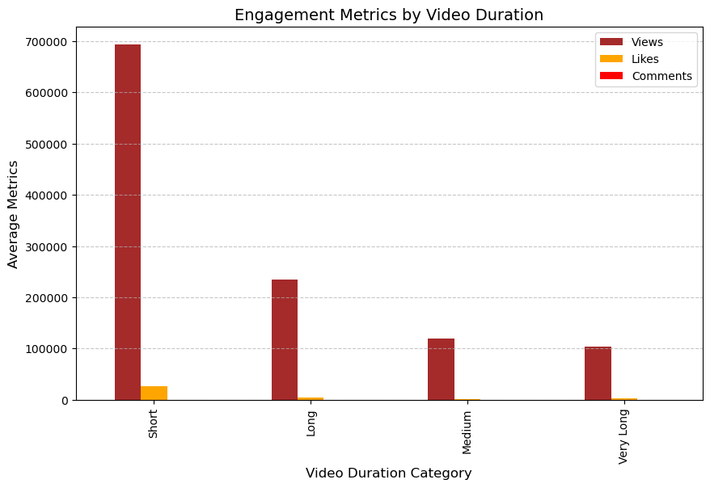
How do video durations affect engagement metrics (views, likes, and comments)?
Short videos outperform longer ones in terms of views, likes, and comments. This suggests that shorter content is more engaging, likely due to viewer preference for quick, easily digestible content.

Slide 5
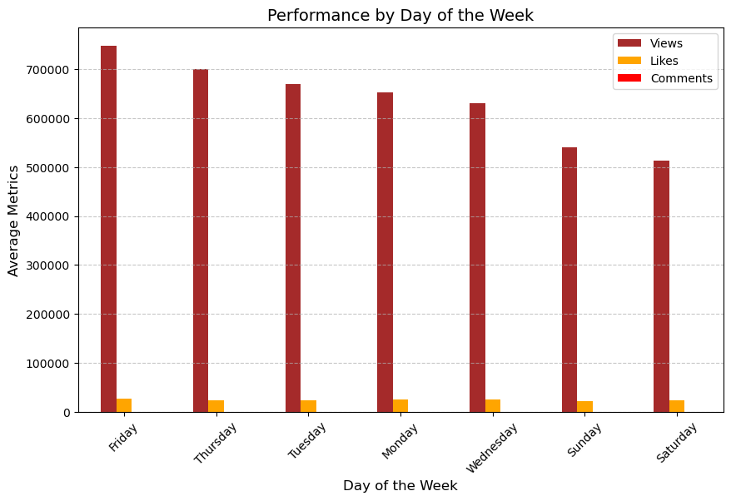
How does the day of the week affect video performance?
Friday is the peak day for video performance, delivering the highest views, likes, and comments. Monday and Thursday offer solid engagement, while weekends and Tuesday show lower performance. To maximize impact, prioritize Friday for important releases and strategically schedule content on Mondays and Thursdays.

Slide 6
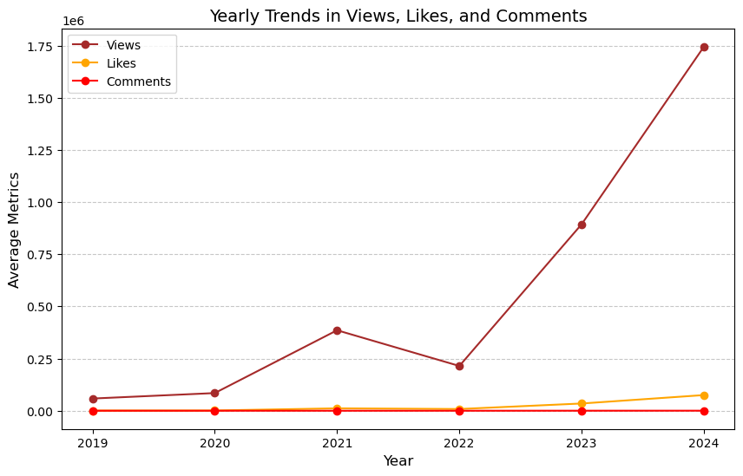
Trend Analysis by Year
The graph shows a significant increase in views, likes, and comments over the years. This indicates growing popularity and engagement with the content. To further boost engagement, focus on increasing comments by encouraging audience interaction.

Slide 7
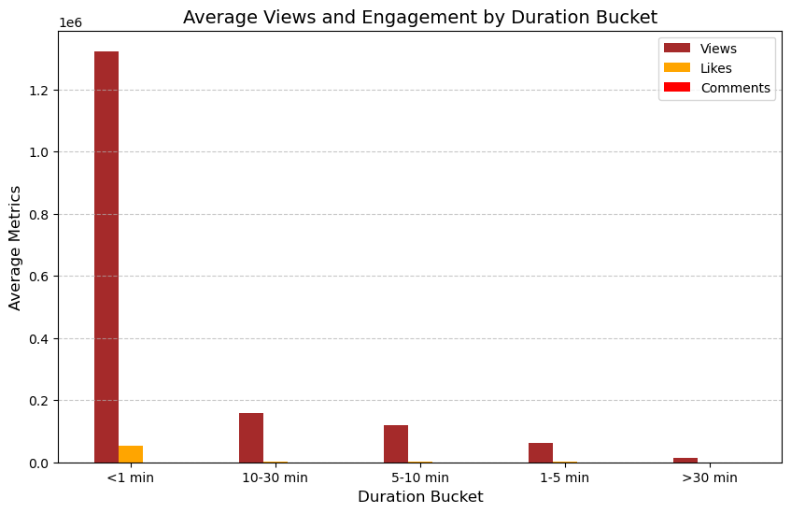
Viewer Retention by Duration Buckets
Average Views and Engagement by Duration Bucket Short videos (<1 min) get the highest average views, likes, and comments, making them the most engaging. Engagement decreases significantly as the duration increases, with longer videos (>30 min) receiving the lowest views, likes, and comments.

Slide 8


